Slide 1
2D game basic artificial intelligence
Course : 2D Game Programming
Effective Period : September 2018

Slide 2
These slides have been adapted from: Pereira, V. (2014). Learning Unity 2D Game Development by Example, Packt Publishing, Inc. San Francisco. ISBN: 9781783559046 Chapter 6
Acknowledgement

Slide 3
Learning Objectives
LO 1 : Create 2D game for PC platform
LO 2 : Apply best practices of 2D game development
LO 3 : Design 2D game for PC platform

Slide 4
What is Game AI?
Makes the characters in the game move
Decide what, where, how, when
Some uses of AI:
Opposing/allied player AI
Character AI
Path planning & collision avoidance
Animation selection

Slide 5
The Goals of Game AI
Games need to be fun!
“Organic credibility”
Create the illusion of intelligence
Players will make up stories about the AI
Rule #1: Don’t look stupid
Rule #2: Try to look smart
But not *too* smart!
Rule #3: Don’t cheat
Rule #3 (revised): Don’t get caught!

Slide 6
Academic AI (vs. Game AI)
Hard, unsolved problems
Scientific method: Simplify & focus down
Planning
Time
Resources
Imperfect knowledge
Failure
Not constrained by performance (mostly)
Checkers/Chess/Go

Slide 7
Game AI (vs. Academic AI)
Avoid unsolved problems like the plague
(unless it’s the core of your game)
You can’t simplify the game away
Time
Resources
Imperfect knowledge
Failure
*Very* constrained by performance

Slide 8
Techniques – Scripted AI
AI Follows a script, much like a movie
Script specifies exactly what will happen, when it will happen, where it will happen
Advantages:
Gives designers explicit control
Easy to write
Easy to balance
Disadvantages
Extremely poor replayability

Slide 9
AI in video games
5-10% of CPU for Realtime
25-50% of CPU for Turn-based
Chase/Escape behaviors
Group behaviors
Finite State machines
Adaptation/Learning

Slide 10
Learning/Adaptation
Increment aggressiveness if player is doing well
The Computer-Based SATs do this!
Levels are a pre-programmed version of adaptation
Tuning
Stability
How might adaptation make play Better or Worse?

Slide 11
What is good AI?
Perceived by user as challenging
Cruel, but fair!
User is surprised by the game
but later understands why
Feeling that reality will provide answers
able to make progress solving problem
What games have used AI effectively?

Slide 12
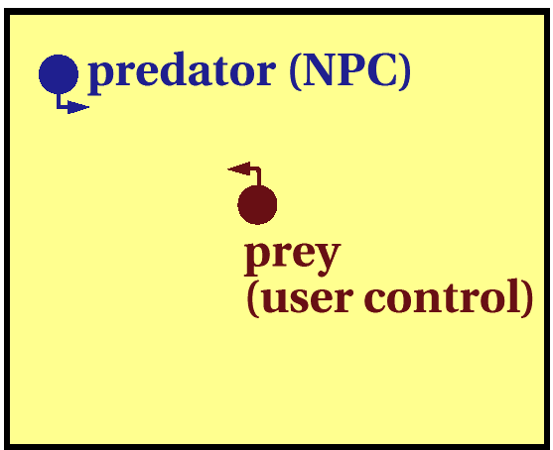
Chase/Evade
Algorithm for the predator?

Slide 13
Techniques – State Machines
States represent a high level view of what the AI is trying to do
Each state has custom code
Transitions occur when the situation changes

Slide 14
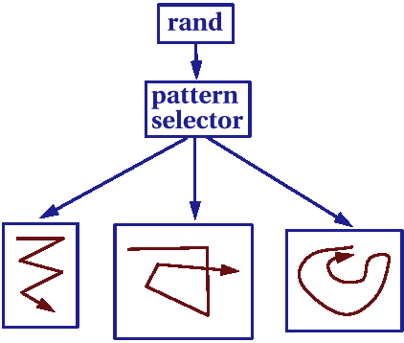
Enhancements to Chase
Speed Control
Velocity, Acceleration max/min
Limited turning Radius
Randomness
Moves
Patterns

Slide 15
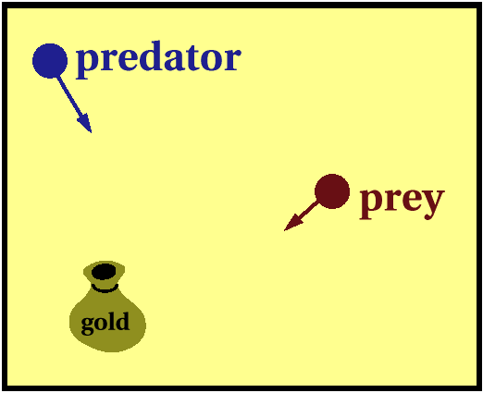
Enhancements to Chase
Anticipation
Build a model of user behavior

Slide 16
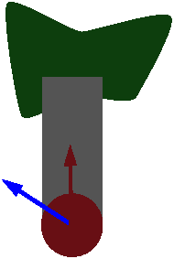

Steering Behaviors
Pursue
Evade
Wander
Obstacle Avoidance
Wall/Path following
Queuing
Combine behaviors with weights
What could go wrong?

Slide 17
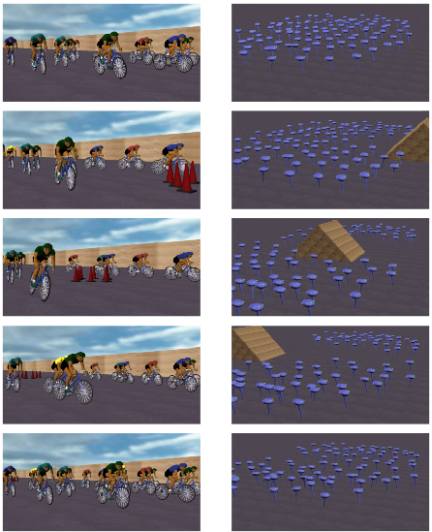
Group Behaviors
Lots of background characters to create a feeling of motion
Make area appear interesting, rich, populated

Slide 18
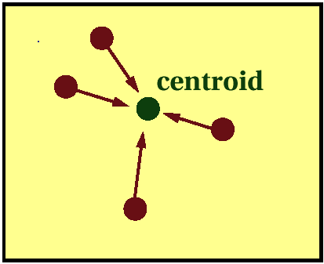
Flocking -- (HalfLife, Unreal)
Simple version:
Compute trajectory to head towards centroid
What might go wrong?

Slide 19
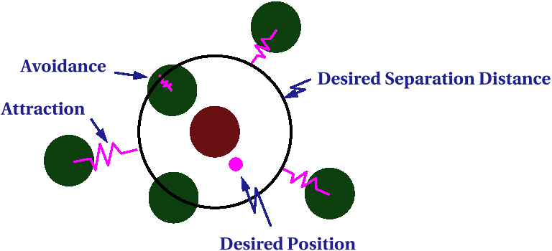
Group Behaviors
Craig Reynolds
SIGGRAPH 1987
Reaction to neighbors -- Spring Forces

Slide 20
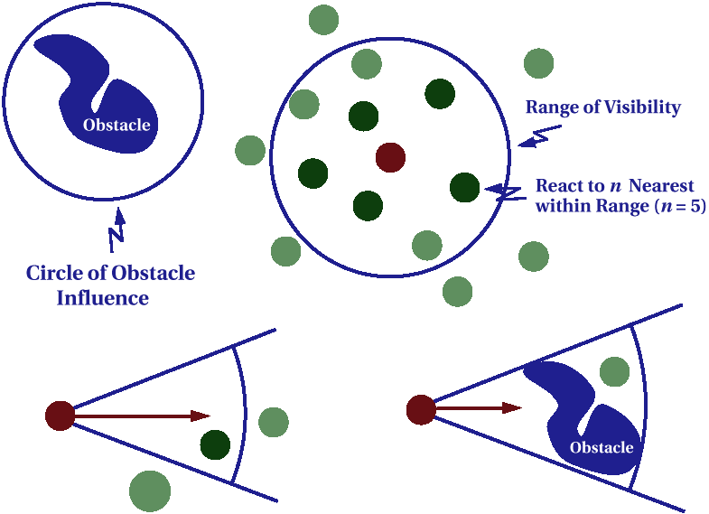
“Perceptual” Models

Slide 21
Production Rules
If( enemy in sight ) fire
If( big enemy in sight ) run away
If( --- ) ----
Selecting among multiple valid rules
Priority weighting for rules or sensor events
Random selection
No state (in pure form)

Slide 22
Finite State Machines
States: Action to take
Chase
Random Walk
Patrol
Eat
Transitions:
Time
Events
Completion of action
Chopping
At woods
Enough wood
Take Wood to
closest depot
At depot
Drop wood:
Go back to woods

Slide 23
State Machine Problems
Predictable
Sometimes a good thing
If not, use fuzzy or probabilistic state machines
Simplistic
Use hierarchies of FSM’s (HalfLife)

Slide 24
Probabilistic State Machines
Personalities
Change probability that character will perform a given action under certain conditions

Slide 25
Probabilistic Example
Enemy Within Hand-
to-Hand Range
50%
Fire At Enemy
Enemy Within Hand-
to-Hand Range
50%
Run Away
Far Enough to
Take Shot
Run out of Range

Slide 26
REMEMBER!!
Upload the prototype of your game on your itch.io sites...

Slide 27
Discussion
Was there a better way for the enemies to be spawned?
Can you propose a better enemy movement?
Discuss with your friends! What kind of AI you are going tp develop for your gamez

Slide 28
References
Calabrese, D. (2014). Unity 2D Game Development. Packt Publishing, Inc. San Francisco. ISBN: 9781783559046
Freeman, J. (2015). Unity’s New 2D Workflow
Vidyasagar. (2014. Unity and C#: Game Loop.CodeProject
Pereira, V. (2014). Learning Unity 2D Game Development by Example. Packt Publishing, Inc. San Francisco. ISBN: 9781783559046

